Slide 1
Instacart Customer Order Analysis
INFO6105 - Data Science Engineering Methods and Tools
Team 23
Ankit Lall, Harshit Mittal

Slide 2
Introduction
Online retail shopping has become a necessity and more and more people and businesses are joining the online market. This also gives organizations an opportunity to better understand their customer and tailor their operations according to customers’ needs for better satisfaction rating and to retain customers.
Crucial benefits of data analysis are that it will lead to increase in sales for businesses, better identify products that can be sold together, improve inventory management. Moreover, it also enhances user’s experience by providing relevant suggestions to them.
The objective of our project is to predict which products a user may want to buy in their next order. Instacart open sourced their transactional data of over 3 million orders, from more than 200,000 Instacart users.

Slide 3
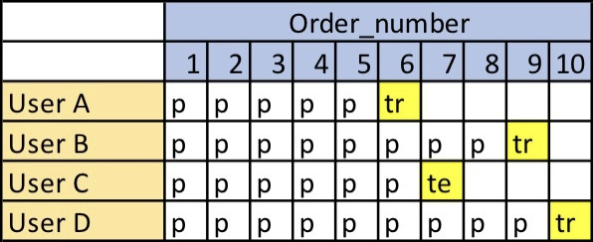
Description of Dataset
The data contains anonymized sample of over 3 million orders from more than 200,000 users. For each user, Instacart provided between 4 and 100 of their orders, along with the sequence in which products were placed in the cart.
Prior data: Order history of every user. This data contains nearly 3-100 past orders per user (~3.2m orders)
Train data: Current order data of every user. This data contains only 1 order per user (~131k orders)
Test data: Future order data of every user . This data will not contain any product information. Essentially, there are the orders for which we have to predict the reorder products for users. (75k orders)
We want to predict which previously purchased products (prior orders) will be in a user’s next order (train and test orders).
The setting of the Instacart problem is described in the figure below.

Slide 4
Dataset Files
aisles.csv - This file contains aisle information. Shape of file is (134, 2).
aisle_id - Unique id for each aisle.
aisle - Name of aisles.
departments.csv - This file contains department information. Shape of file is (21,2).
department_id - Unique id for each department.
department - Name of departments.
order_products_train.csv – This file consists of all product details for a train order. Shape of file is (1384617, 4).
order_id - Unique id for each order.
product_id - Unique id for each product.
add_to_card_order - specifies the sequence of added products.
reordered - whether a product was reordered or not.

Slide 5
Dataset Files (Cond.)
order_products_prior.csv - These files contain data about which products were purchased in each order. Shape of file is (32434489, 4)
order_id - Unique id for each order.
product_id - Unique id for each product.
add_to_card_order - specifies the sequence of added products.
reordered - whether a product was reordered or not.
orders.csv - This file contains prior, train, test order details placed by any user. Shape of file is (3421083, 7)
order_id - Unique id for each order.
user_id - Unique id for each user.
eval_set - Category of order (prior/train/test)
order_number - order sequence of a user.
order_dow - day of the week when order placed.
order_hour_of_day - Time of the day when order placed.
days_since_prior_order - Number of days between two orders.

Slide 6
Dataset Files (Cond.)
products.csv - This file contains product details. Shape of file is (49688, 4)
product_id - Unique id for each product.
product_name - Name of products.
aisle_id - Unique id of aisle where product is kept.
department_id - Unique id of department to which this product belongs.

Slide 7
Methodology
Since, we have to predict multiple products for a given order, this might look like a multilabel classification task. There are 49688 products, and total product recommendations could be anywhere from None to N. Therefore, we will restructure this problem into a binary classification problem
To build a machine learning model, we need to extract additional features from orders data to understand user's purchase pattern and popularity of all the products.
Product Level Features
Aisle and Department Level Features
User Level features
User-product Level Features
We shall follow below processes to achieve our goal of predicting a reorder in an efficient manner:-
Data cleaning and pre-processing
Exploratory Data Analysis
Feature engineering
ML algorithms

Slide 8
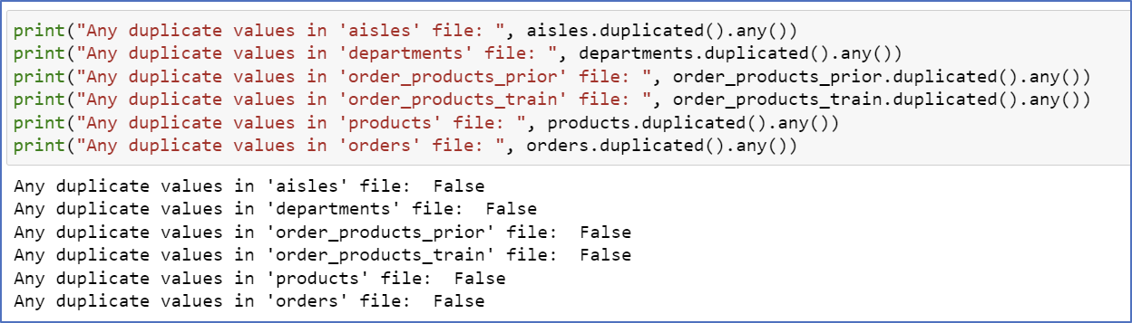
Data cleaning and Pre-processing
We shall scan and verify the data for below anomalies
Deduplication:
We shall load all the provided files of the dataset and look for duplicate values using the ‘duplicated()’ method. Post analyzing the files we found that no file has duplicate values.

Slide 9
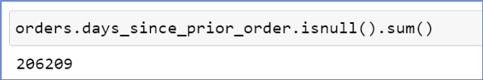
Data cleaning and Pre-processing (Contd.)
Missing values
We can see none of the files have any null values, except ‘orders.csv’ file. The column ‘days_since_prior_order’ has null values.
Upon analyzing this data, we find out that there are total 206,209 null values in this column. This is the exact number of unique users in our dataset.
Reason behind these null values is that for the first order of every user, value for days since prior order will be N/A.
We shall replace these null values with 0 while preparing the dataset.

Slide 10
Data cleaning and Pre-processing (Contd.)
We need to perform some data analysis to gather valuable insights from this data. So, we shall merge different files and select useful fields as per the requirement.
We shall merge ‘order_products_prior’ and ‘order_products_train’ dataset, to get a cumulative dataset comprising of all ‘train’ and ‘prior’ order-product details.
We shall now merge ‘orders’ and ‘order_products_merged’ dataset to club all the above order information with the complete order details.
We will also merge the above dataset with ‘products’, ‘aisles’, ‘departments’, and ‘orders’ datasets to get an all-encompassed dataset which contains all the order, product details for all orders (except test orders).
We shall merge ‘products’, ‘departments’, and ‘aisles’ dataset to get a comprehensive view of all details regarding products. We can now view the product names, respective departments which they belong to, respective aisles which they belong to, etc.

Slide 11
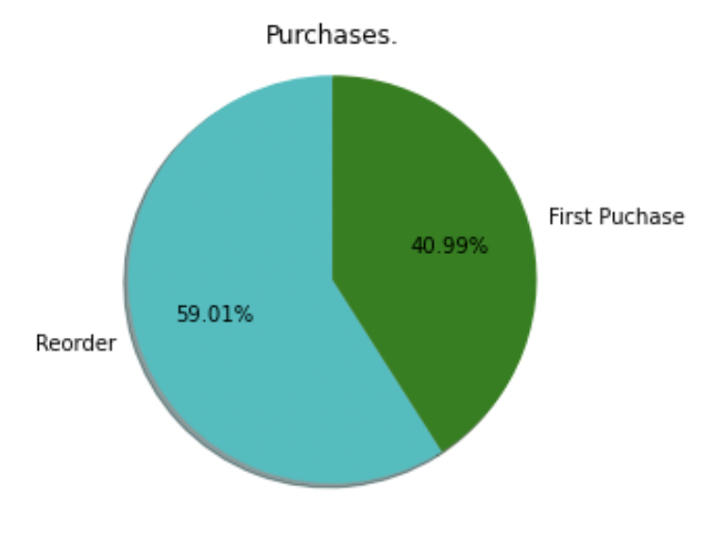
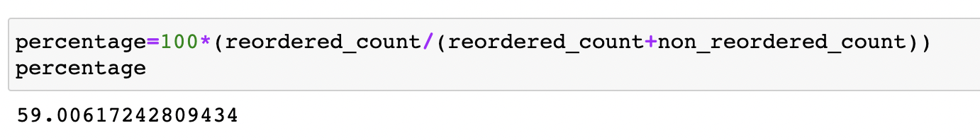
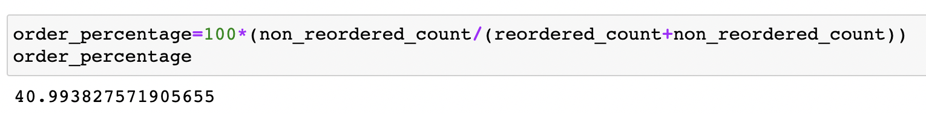
Exploratory Data Analysis
This is an important first step in our analysis as it helps us uncover some powerful insights from the data and answer some interesting questions and can help us perform better feature engineering.
Our analysis helped us answer the following questions.
How many percent of purchases are first purchase and how many are reorders.
From the pie chart it is evident that more than half i.e around 60% of the orders in the dataset are reorders.
Only around 41% of the orders were first orders.

Slide 12
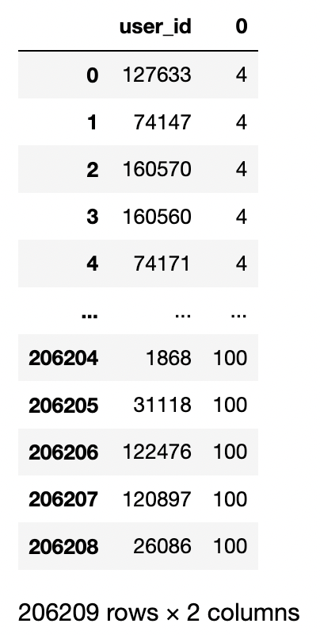
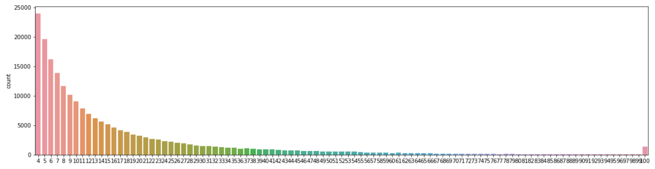
Exploratory Data Analysis (Contd.)
Number of orders placed by each user.
Each user in the dataset have at least 4 orders and at most a 100.
From the histogram it can be inferred that most users have placed order in the range 4-60.

Slide 13
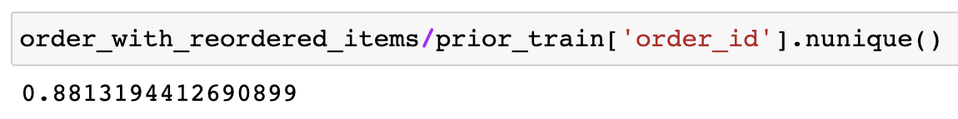
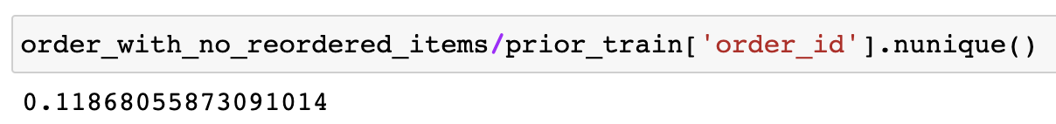
Exploratory Data Analysis (Contd.)
How many Orders with no reordered products
Around 88% of orders have reordered items.
.
Around 12% of orders have no reordered items.

Slide 14
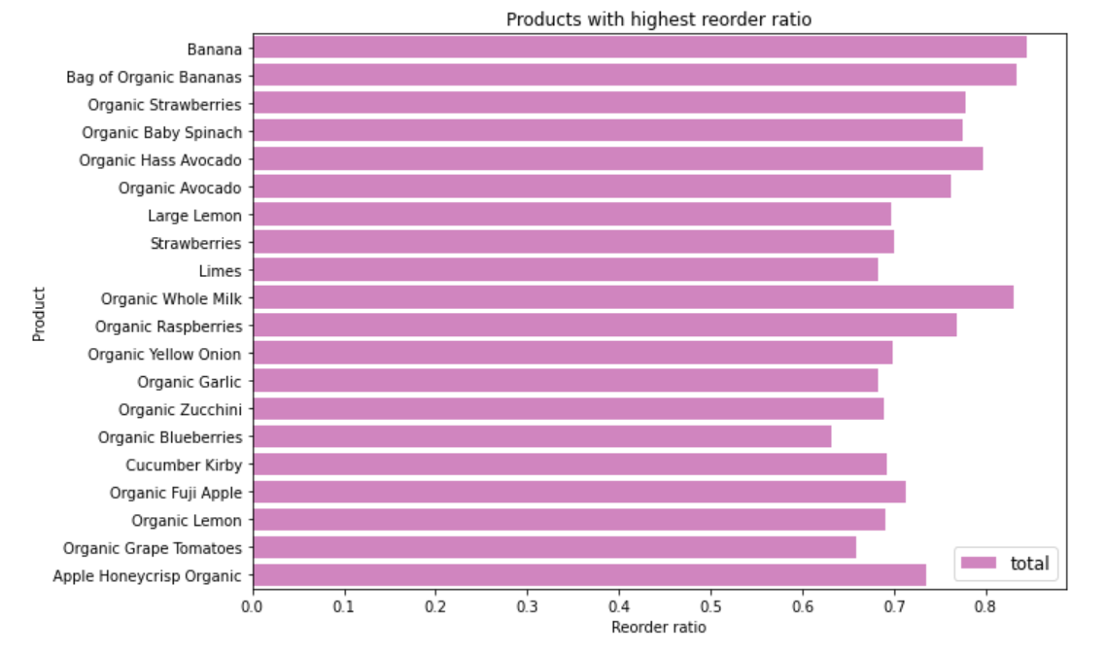
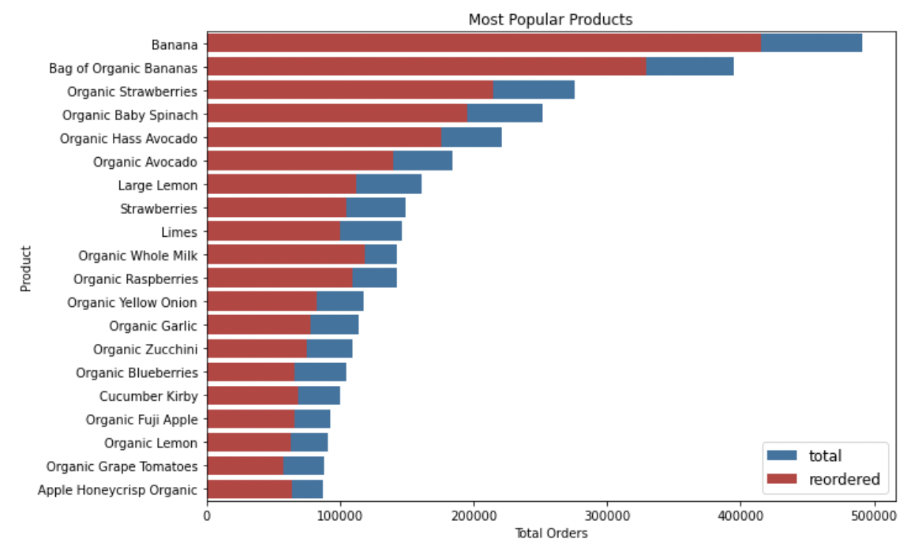
Exploratory Data Analysis (Contd.)
Which are the most frequently ordered / reordered products.
A total of 49685 products were ordered.
The most popular products (Top 5) are also organic in nature.
Bananas are the most ordered and reordered product and most of the products which were ordered are organic products.

Slide 15
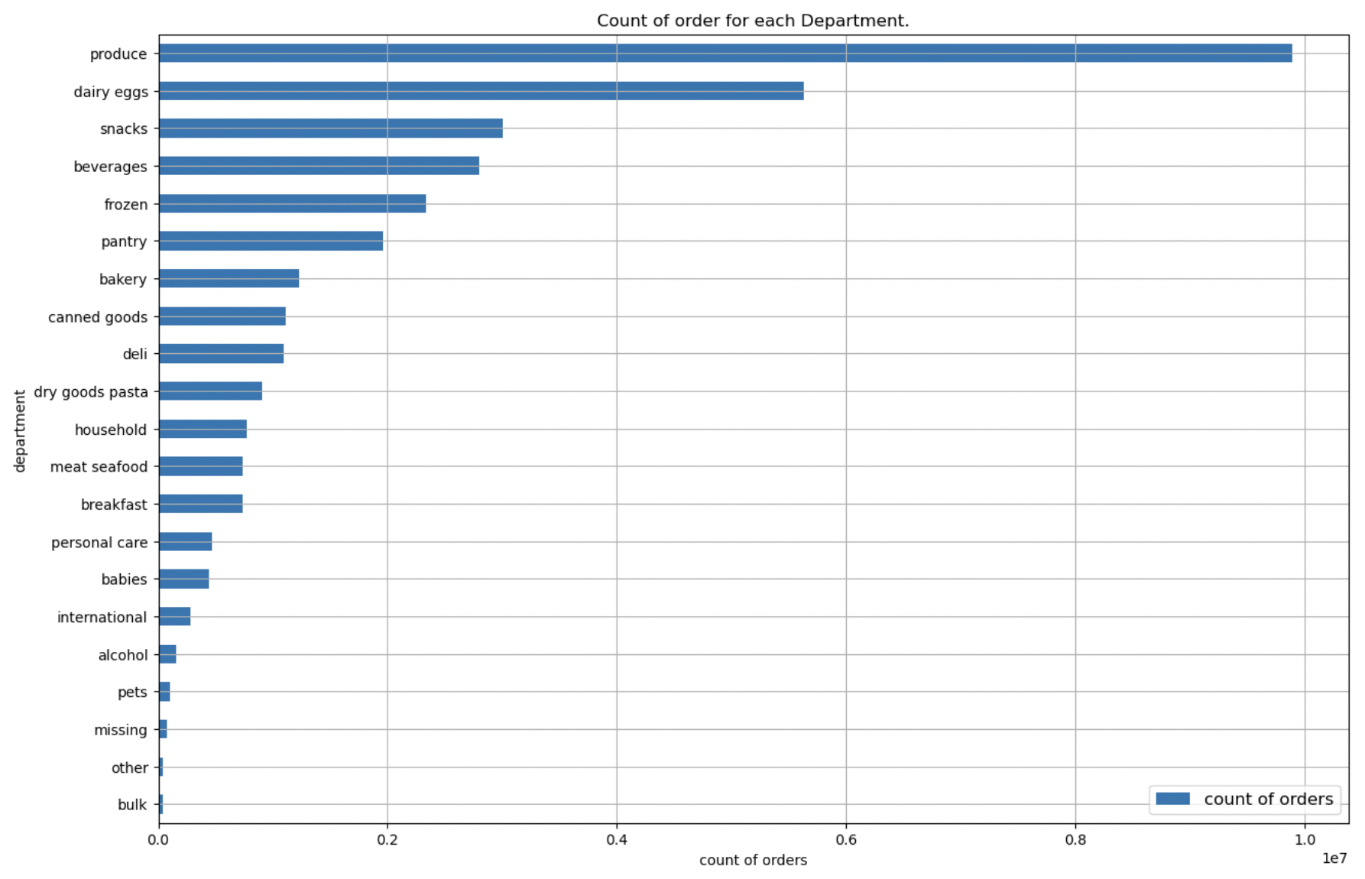
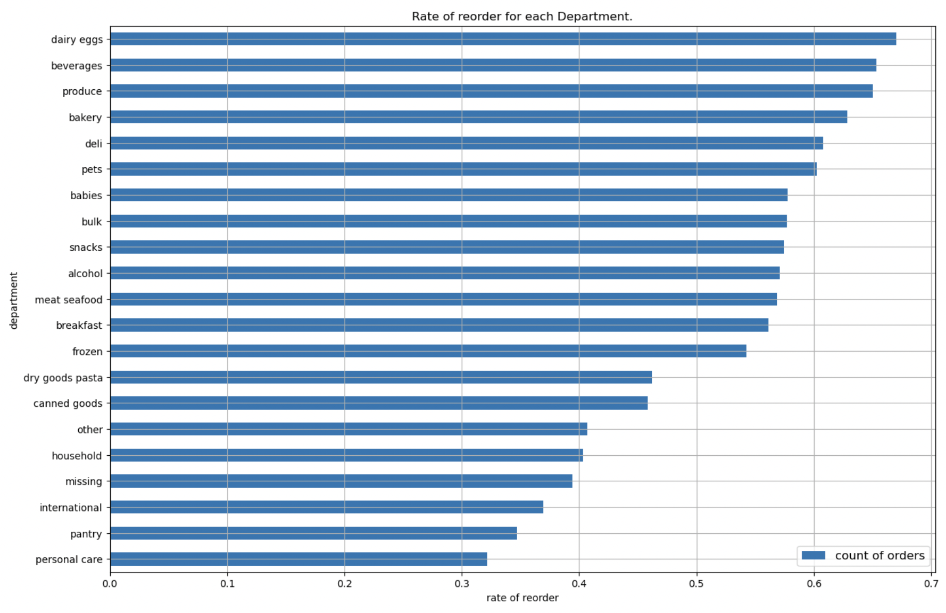
Exploratory Data Analysis (contd.)
Frequently ordered and reordered products categorized by department.
There are a total of 21 departments.
Most of the ordered products are from the produce department which includes fruits, vegetables, etc.
The least ordered items belong to the bulk department.
There is high reorder rate in organic foods and daily consumables. Most reordered products belong to dairy eggs department which includes eggs, yogurt, cheese etc.
There is low reorder rate in personal care department which makes sense as these items last longer and are used less often.

Slide 16
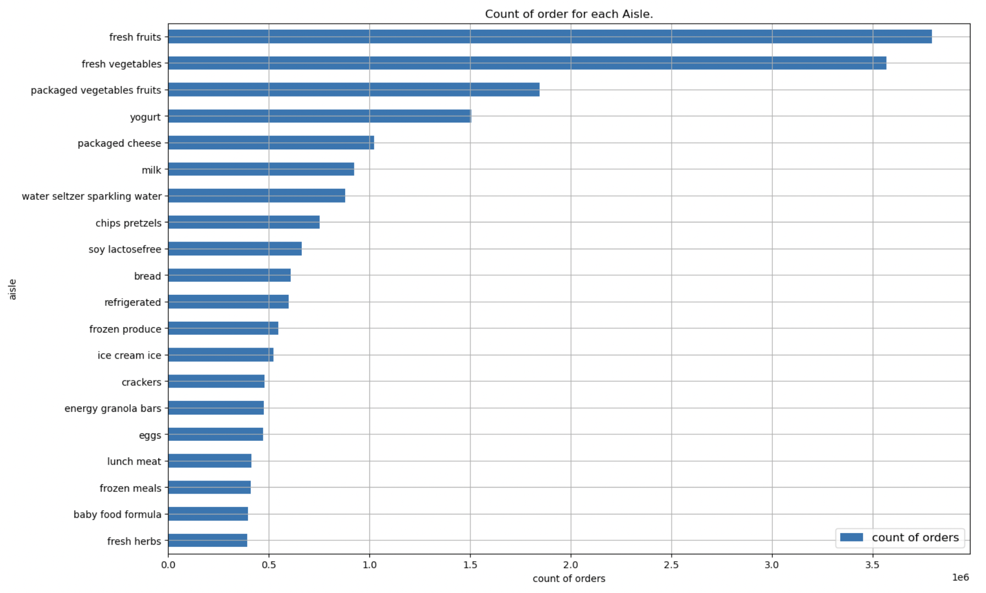
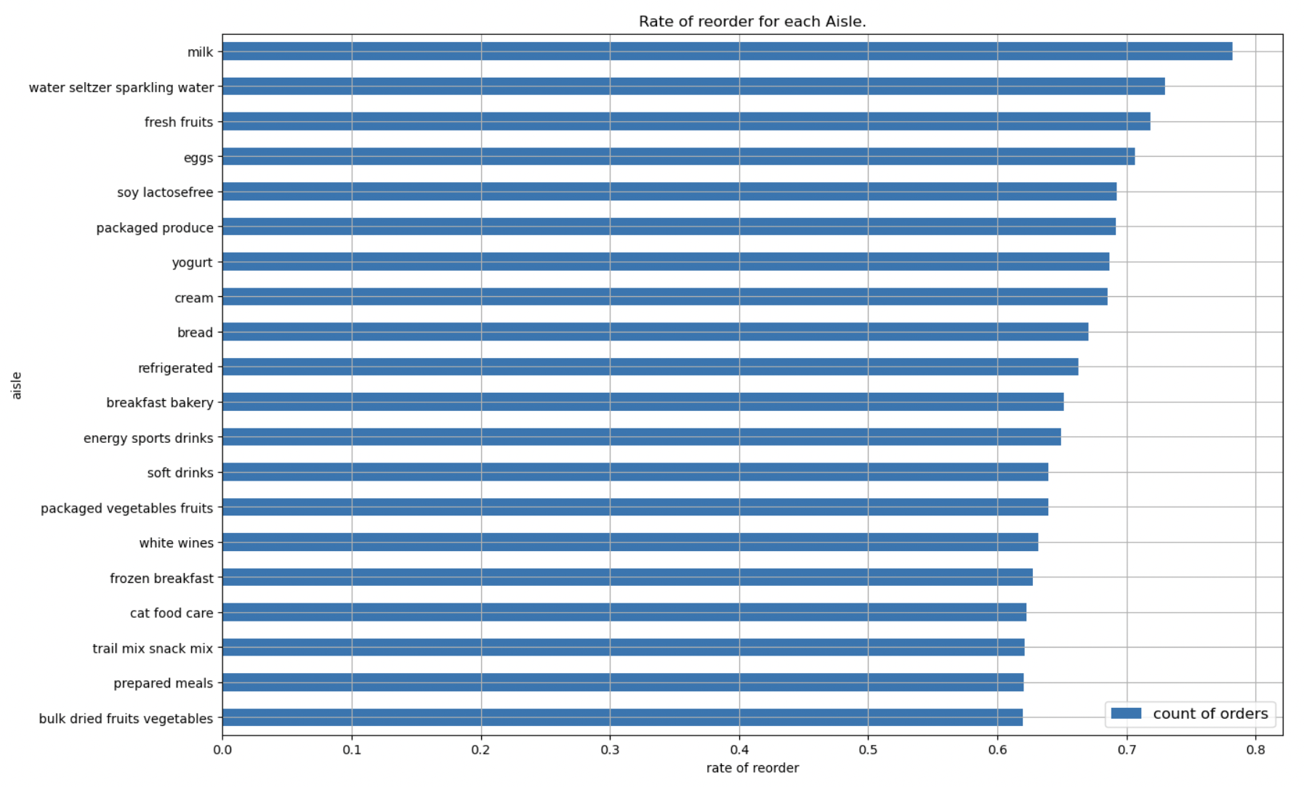
Exploratory Data Analysis (Contd.)
Frequently ordered and reordered products categorized by aisle.
There are a total of 131 aisles.
It can be seen that most ordered items are from fresh fruits and fresh vegetable aisles. Other frequently ordered aisles are packaged vegetables fruits, yogurt, and packaged cheese aisles.
Items bought least frequently are from fresh herbs, baby food formula, frozen meals, lunch meat aisle.
Most reordered items are from aisles - milk, sparkling water, fruits, eggs. These items are daily used items which makes sense as one rarely ever changes their meal plan.
Moreover, these are perishable products that don’t last very long.

Slide 17
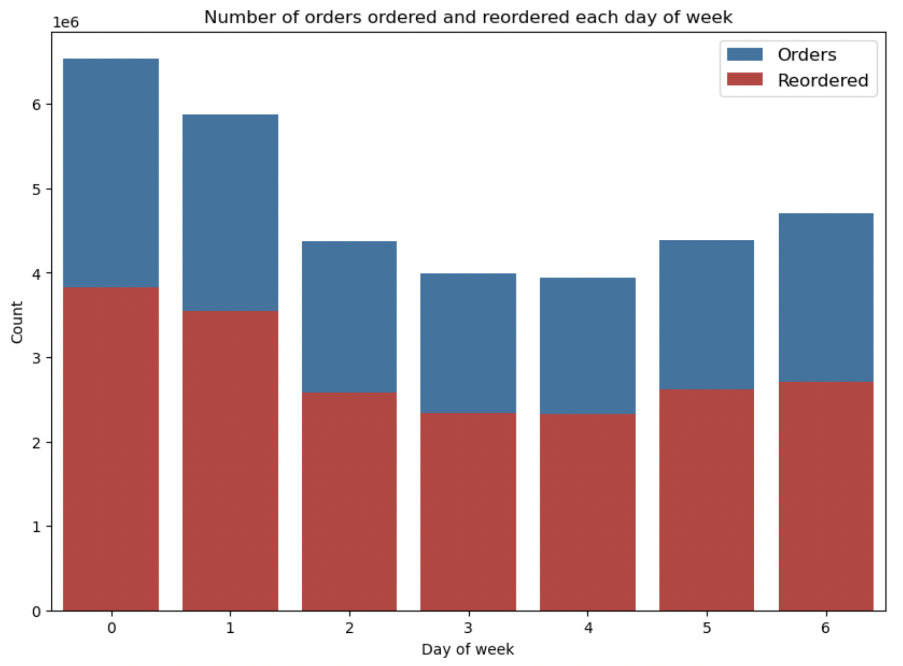
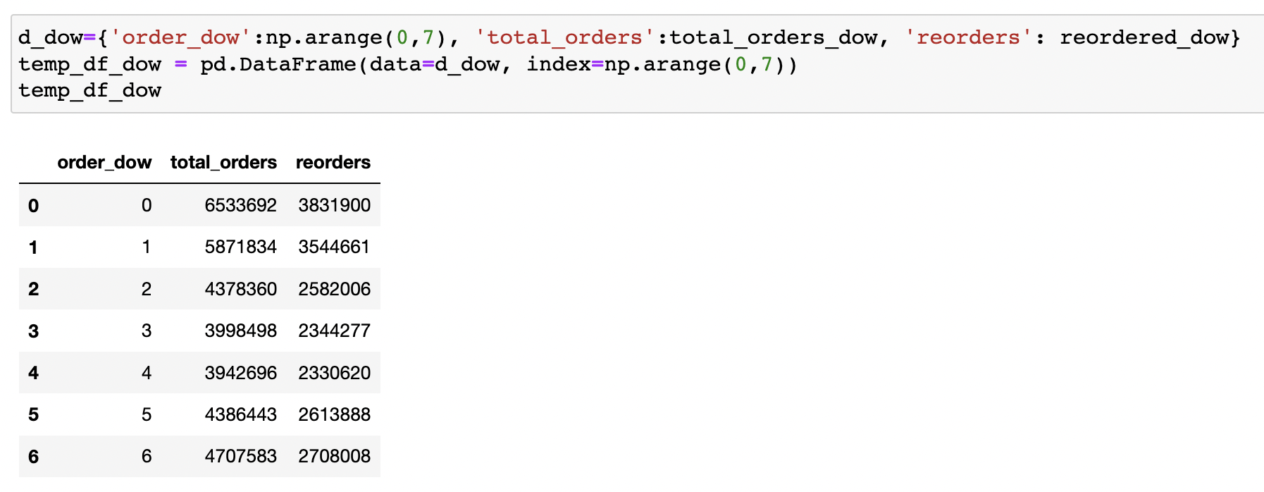
Exploratory Data Analysis (contd.)
Number of products ordered and reordered in a particular day of the week.
Considering that week starts on Sunday most orders and reorders were made on Sunday and Monday. Least orders and reorders were made in the middle of the week i.e Wednesday and Thursday. Based on the graph we can say that customers tend to restock at the start of the week.
Orders and reorders are proportionally same for all the days of the week.

Slide 18
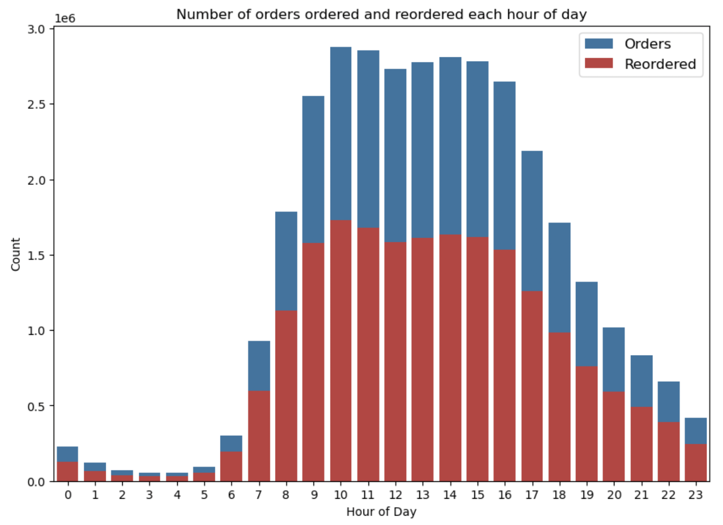
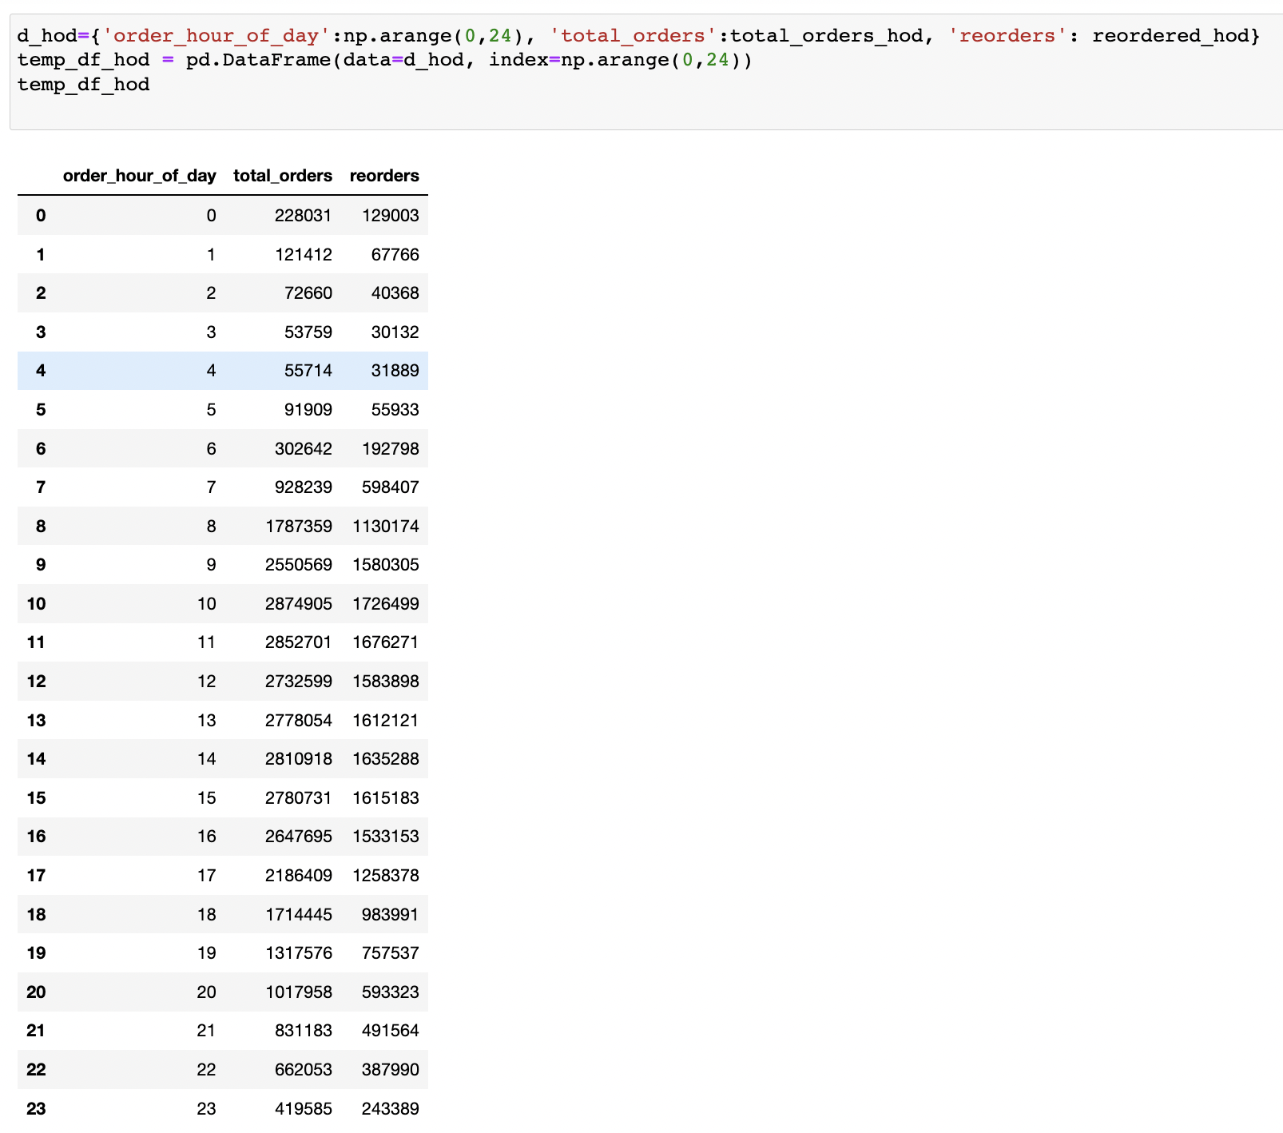
Exploratory Data Analysis (Contd.)
Number of products ordered and reordered in a particular hour of the day.
From the graph above it can be inferred that most of the orders and reorders were made from morning to midnight with higher frequency between 9 AM to 5 PM. While very few orders and reorders were made from midnight to early morning.

Slide 19
Feature Engineering
Merging Data
First we merge prior product order data with orders. The resultant DataFrame contains some important columns which will be useful when creating new features.
Feature Creation
Firstly we create product-level features as follows:
Product_bought_rate - This feature denotes the rate at which a product was bought by a user.
Product Features:
prod_add_to_cart_order_mean - Average position of a product in the cart w.r.t mean of each value in add_to_cart_order.
prod_order_total - This is the total number of times a product was ordered by calculating total count of a product in reorder column.
prod_reorder_total - Total number of times a product was reordered by calculating sum of times product was reorder.
prod_reorder_rate - Reorder rate of a product by calculation avg of reorders for each product.
prod_unique_users - Total number of unique users by getting unique occurrences of each user.
first_order_total - Product buying rate for the first time by calculating sum of product_bought_rate where it is equal to 1
second_order_total - Product buying rate for the second time by calculating sum of product_bought_rate where it is equal to 2.
is_organic - Check whether a product is organic or not by inputting 1 if product has ‘organic’ else 0.

Slide 20
Feature Engineering (Contd.)
Aisle Features:
aisle_add_to_cart_order_mean - Aisle cart position by calculating add_to_cart_order mean for each aisle.
aisle_add_to_cart_order_std - Aisle cart std by calculating add_to_cart_order std for each aisle.
aisle_order_total - total orders made for each aisle by calculating count of all reorders for each aisle.
aisle_reorder_total - total reorders made for each aisle by calculating sum of all reorders for each aisle.
aisle_reorder_rate - reorder rate for each aisle by calculating mean of all reorders for each aisle.
aisle_unique_users - unique users for each aisle by fetching unique values in user_id column.
Department Features:
dept_add_to_cart_order_mean - Department cart position by calculating add_to_cart_order mean for each department.
dept_add_to_cart_order_std - Department cart std by calculating add_to_cart_order std for each department.
dept_order_total - total orders made for each department by calculating count of all reorders for each department.
dept_reorder_total - total reorders made for each department by calculating sum of all reorders for each department.
dept_reorder_rate - reorder rate for each department by calculating mean of all reorders for each department.
dept_unique_users - unique users for each department by fetching unique values in user_id column.

Slide 21
Feature Engineering (Contd.)
In the next step, we merge all the new features data frames into one product features data frame.
Next remove the following unnecessary fields from the data frame - 'product_name', 'aisle_id', 'department_id'.
Then encode 'aisle_id' & 'department_id' columns using category_encoders module’s BinaryEncoder.
Next, create user-level features as follows:
dow_mean - order day of week avg for each user by calculating mean of order_dow.
dow_std - order day of week std for each user by calculating std of order_dow.
doh_mean - order hour of day avg for each user by calculating mean of order_hour_of_day.
doh_std - order hour of day std for each user by calculating std of order_hour_of_day.
days_since_prior_order_mean - number of days since prior avg for each user by calculating mean of days_since_prior_order.
days_since_prior_order_std - number of days since prior for each user by calculating std of days_since_prior_order.
unique_orders_by_user - unique orders for each user by fetching unique values in order_number column.
unique_product_by_user - unique products for each user by fetching unique values in product_id column.
products_by_user - totat products bought by a user by calculating total count.
reorders_by_user - total reorders made by each user by calculating sum of all reorders for each user.
reorder_rate_by_user - reorder rate for each user by calculating mean of all reorders for each user.
order_size_avg - User's average size of order by calculating total count of reorders on data grouped by user_id & order_number and then grouped by user_id of the new data frame.
reorder_in_order - User's mean of all orders of reorders by calculating total count of reorders on data grouped by user_id & order_number and then grouped by user_id of the new data frame.
orders_1, orders_2, orders_3 - total number of order items in the user's last three orders.
reorder_1, reorder_2, reorder_3 - reorder rate in the user's last three orders.

Slide 22
Feature Engineering (Contd.)
Next, create user product features as follows:
total_orders_by_user - Total orders by a user for a product by calculating the count of all reorders on data grouped by user_id & product_id.
total_reorders_by_user - Total reorders by a user for a product by calculating the sum of all reorders on data grouped by user_id & product_id.
user_reorder_rate - Reorder rate of a user for a product by calculating the mean of all reorders on data grouped by user_id & product_id.
add_to_cart_by_user_mean - Cart order of a user for products by calculating the mean of add_to_cart_order on data grouped by user_id & product_id.
days_since_prior_order_avg - Average days since the prior order of a user for products by calculating the mean of days_since_prior_order on data grouped by user_id & product_id.
product_last_bought_order - order number when the product was last ordered on data grouped by user_id & product_id.
is_reorder_3, is_reorder_2, is_reorder_1 - Product in last three orders.
Now we must merge train data with orders data and remove the following unnecessary columns - eval_set, add_to_cart_order, order_id.
Filter user product features for all unique users in train data.
Impute null values with mean values for the following columns - order_number, order_dow, order_hour_of_day, days_since_prior_order.
Then remove orders which were purchased for the first time in the last three orders.
Finally, merge product and user features with the final features data.

Slide 23
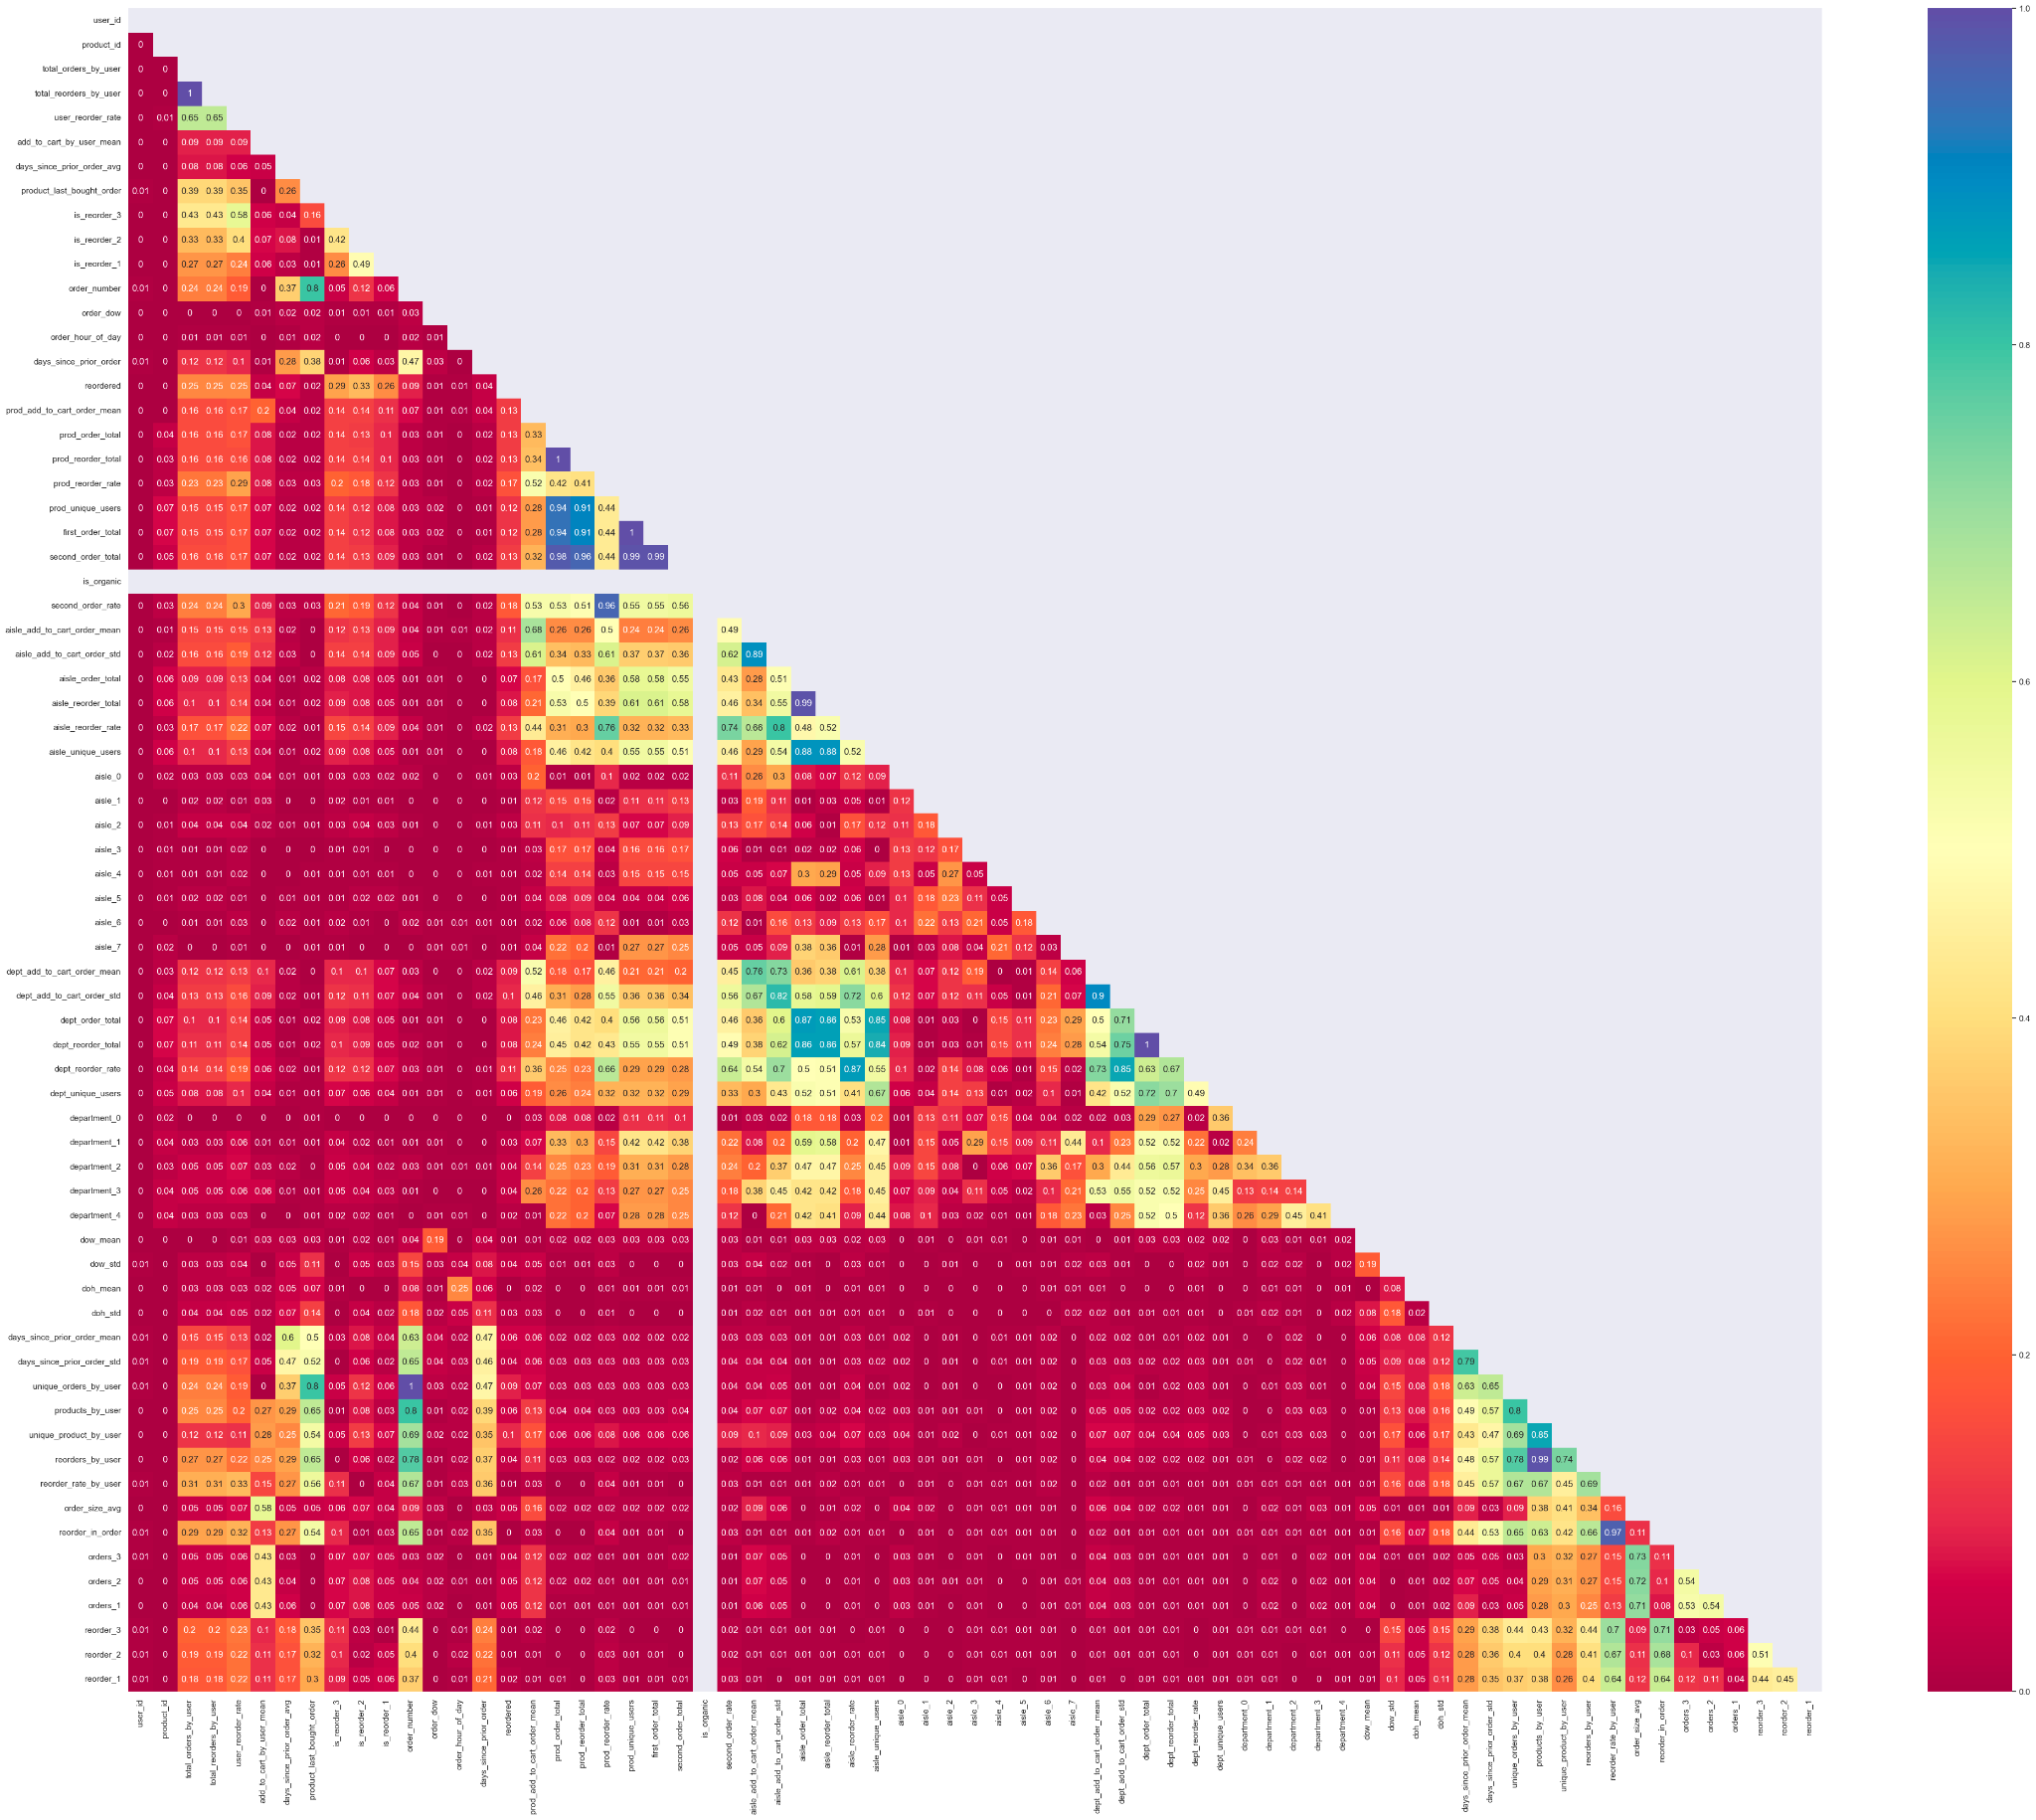
Feature Engineering (Contd.)
Based on our previous analysis using models we found there is an overfitting issue.
To fix this problem we have removed the correlation between features.
By doing so we were able to reduce the total number of feature columns to 52.

Slide 24
Modelling strategies
We shall use below machine learning models to solve the classification problem:
Logistic regression
Decision tree classifier
Random Forest classifier
XGBoost classifier

Slide 25
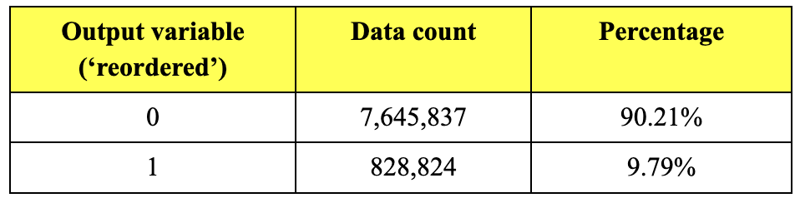
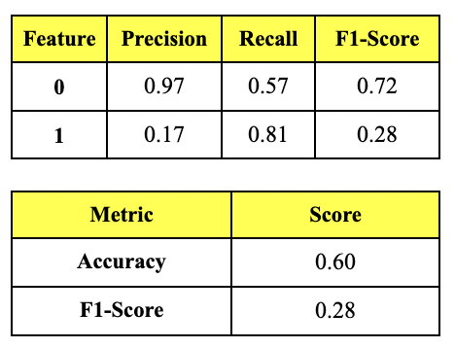
Modelling strategies (Contd.)
Logistic Regression
We had to reduce the memory consumption of it by sampling 50% of the data. Also, in our final dataset,
We encounter huge class imbalance.
Post optimizing the model and training it over multiple combinations, we observed below results.

Slide 26
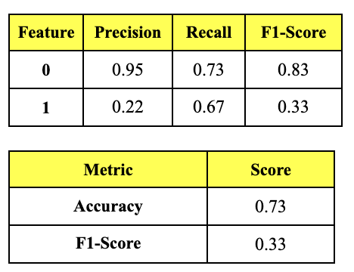
Modelling strategies (Contd.)
Decision Tree classifier
We started by training the model on complete dataset which had huge class imbalance. Model accuracy for category 0 (not reordered) raised to 90%, but for category 1 (reordered) it became NILL.
We observed that model was overfitting and to remove this overfitting issue, we eliminated the collinear features from the dataset. We used the parameter 'class_weight' in the model estimator and set it to {0:1, 1:10} to tackle class imbalance issue.
Post optimizing the model and training it over multiple combinations, we observed below results.

Slide 27
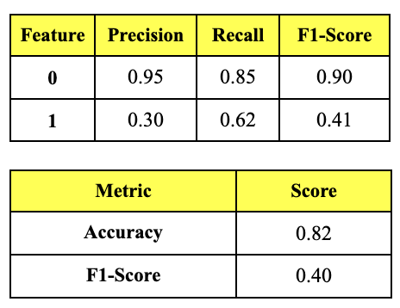
Modelling strategies (Contd.)
Random Forest classifier
We started by training the model on complete dataset which had huge class imbalance. Model accuracy for category 0 (not reordered) raised to 90%, but for category 1 (reordered) it became NILL.
We used ‘RandomizedSearchCV’ method to perform cross-validation with each combination of parameter values such as 'max_depth': [10,15,20,25], 'min_samples_split': [1,2,3], 'class_weight': [{0:1, 1:10}] and used the best fit set to optimize the model.
Post optimizing the model and training it over multiple combinations, we observed below results.

Slide 28
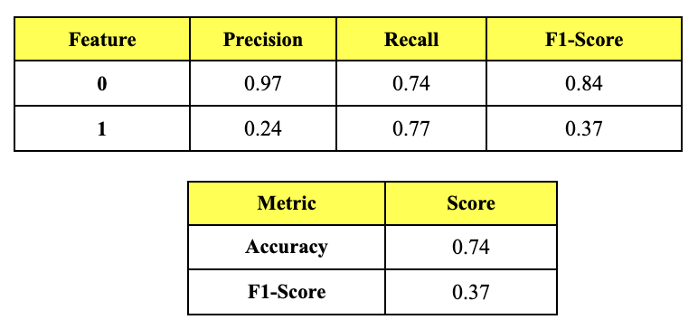
Modelling strategies (Contd.)
XGBoost classifier
We started by training the model on complete dataset which had huge class imbalance. Since XGBoost algorithm handles class imbalance inherently better than some other models, we got a better initial score when compared to previously tested models. But the score was still not satisfactory.
We also used ‘GridSearchCV’ method to perform hyper-paramter tuning on multiple combinations of parameter values. Then we got the best parameter values as "objective”: "reg:logistic", "eval_metric": "logloss", "eta": 0.1, "max_depth": 6, "min_child_weight":10, "gamma": 0.70, "subsample": 0.76, "colsample_bytree": 0.95, "alpha": 2e-05, "scale_pos_weight": 10, "lambda":10 and used this best fit set to optimize the model.
Post optimizing the model and training it over multiple combinations, we observed below results.

Slide 29
Conclusion
We built 4 Machine learning models with over 50+ features to solve the supervised binary-class classification problem.
We compared all the performance metrics scores of these models and analyzed the significance of each.
Precision and recall scores in predicting both, 0 and 1 are higher for Random Forest algorithm as compared to other models. This means that the model can efficiently predict true positive values of 0 and 1. Consequently, the overall F-1 score for Random Forest model was the highest in our analysis.
Therefore, we can confidently say that ‘Random Forest classifier’ is the best performing model for our use-case.

